Slide 1
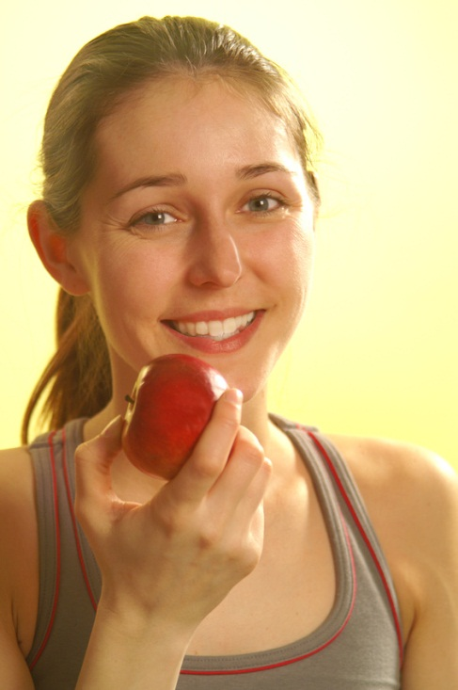
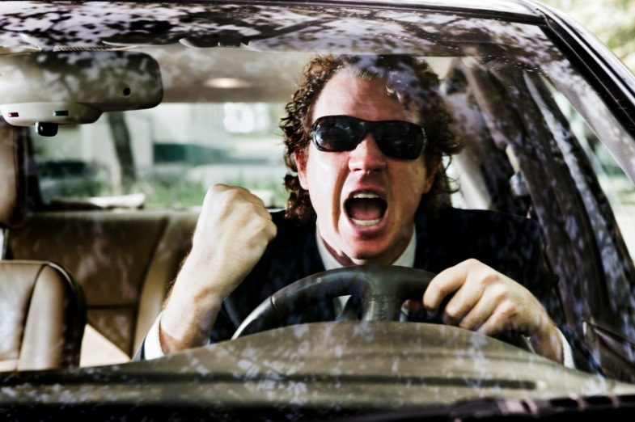
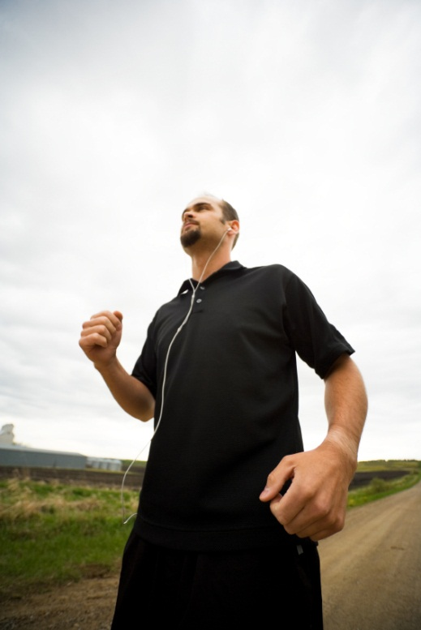
Staying Healthy during the “crazy”
Jill Diaz and Gina Williams

Slide 2
What is HEALTH?
Mind
Body
Relationships

Slide 3
wHAT ARE YOUR OBSTACLES?
NO time
Never ending To-Do list
Being pulled in different directions
Affordability
Nobody else is doing it
Temptation
Away from home

Slide 4
A healthy mind

Slide 5
Important questions
How do you start your day?
Do you take a lunch or any small breaks?
How do you end your day?
What is important to YOU?
What are your goals?

Slide 6
Tools to stay present
Taking 5 minutes to walk around, listen to music, read etc.
Journaling
Being okay with silence
Meditation
Having a lunch buddy
PUT YOUR PHONE/COMPUTER AWAY!
“If you are depressed, you are probably thinking of the past. If you are anxious, you are probably thinking of the future.”

Slide 7
Resources
Apps:
Take a break!
Calm
Mindfulness

Slide 8
A healthy body

Slide 9
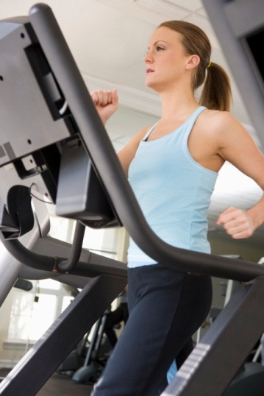
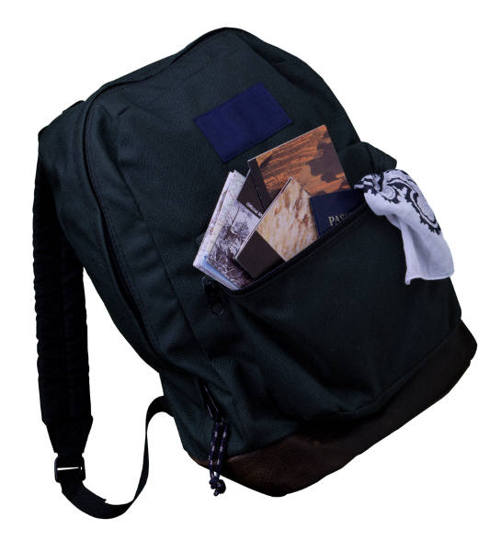
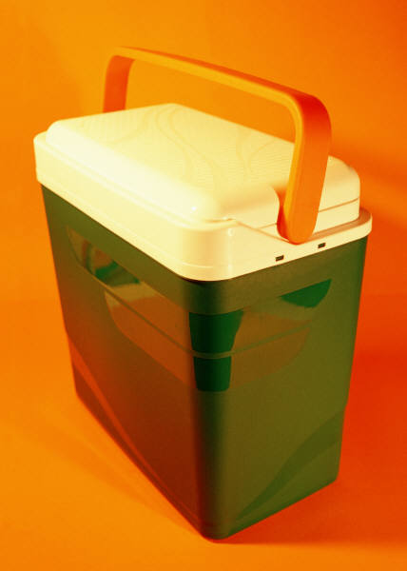
Preparation
Meal Prep
Write out your week
If Traveling Check hotel site for fitness facility
Does your school have a facility?
Pack comfortable exercise gear
Bring small cooler for snacks
If you are running on your own: bring phone, whistle, etc.
Accountability- find a workout buddy
Planning is your key to SUCCESS
Notes:
Visit your hotel’s website to find out if they offer fitness facilities, any extra charges, or safe parks/preserves to walk or run
Pack comfortable pair of walking/running shoes, bathing suit, exercise bands, jump rope

Slide 10
What to EAT
In the Car/Office
Water
Fruit and veggies
Granola bars
String cheese
Whole grain chips/crackers
Nuts like almonds, cashews, walnuts
Sandwiches on whole grain bread, PB & J/lean meat
Less ingredients the BETTER
Notes:
Eat healthy snacks in the car:
Load up on fresh-cut vegetables and fruit. Bring along a small cooler with ice packs to keep your snacks fresh.
Bring plenty of water. It will keep you hydrated and, if you spill it, won't stain the upholstery like sodas.
Individually wrapped portions of string cheese or vegetarian cheese alternatives can be kept in the cooler with the fruit and vegetables. They are a great source of calcium and protein.
Bring baked whole grain crackers along on your trip. This is good for added fiber and nutrients.
Don't overindulge in greasy chips. There are baked varieties that have a lot less unhealthy fats. You need to watch how much you eat of those too, however, since they don't offer much in the way of nutrition.
You can also pack sandwiches made with whole grain bread and peanut butter or lean meats. Keep these in the cooler, too.
Nuts such as almonds, cashews, and walnuts contain polyunsaturated fats and are easy to take on a trip in either individual bags or larger containers.

Slide 11
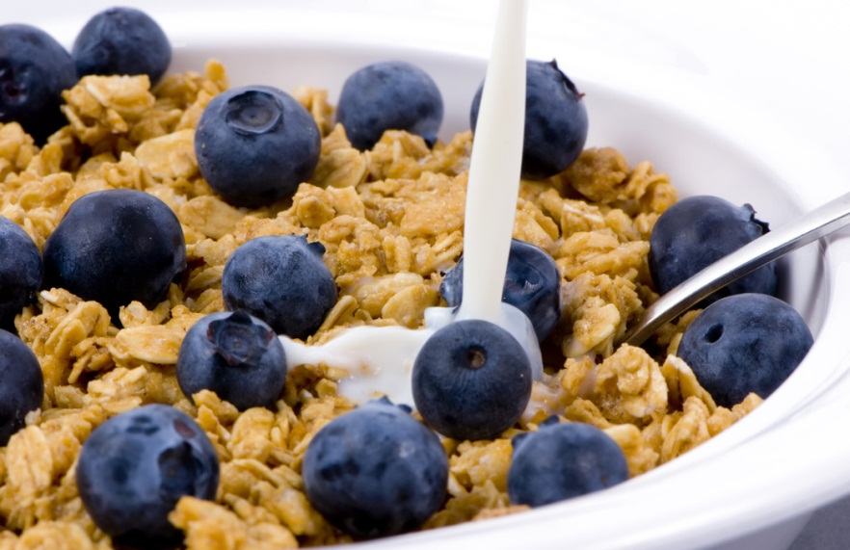
What to Eat
In Hotel
Cereal with low fat milk
Fresh fruit
Yogurt
Oatmeal
Omelet with veggies
Whole wheat toast/muffin
Avoid muffins, sweet rolls, sugary cereal
Notes:
At the hotel continental breakfast bar:
Choose a whole grain cereal with low-fat milk.
Fresh fruit gives you vitamins and fiber.
Yogurt or hard-boiled eggs are good sources of protein.
Avoid sugary muffins, sweet-rolls, and pre-sweetened cereal.

Slide 12
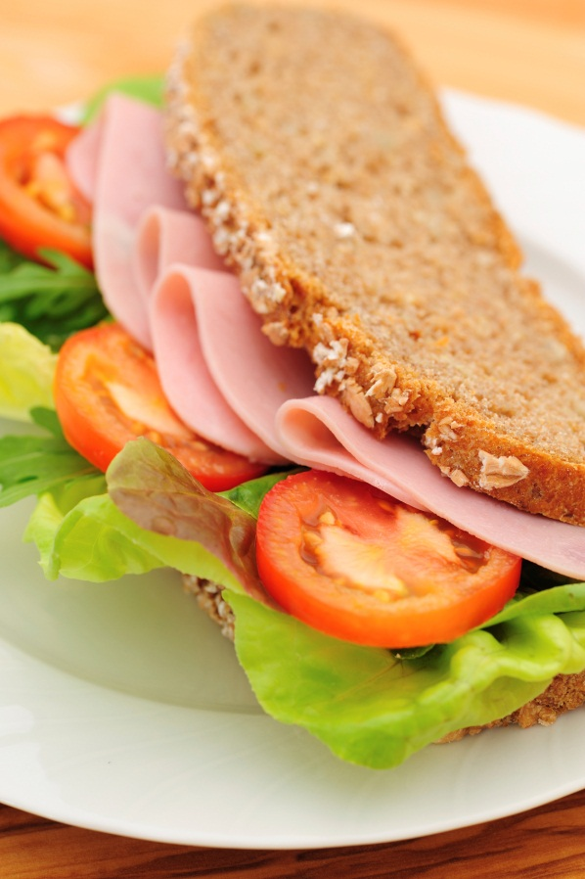
What to EAT
At College Fairs/Work Events
Water, avoid sugary pop
Whole grain sandwiches
Use mustard instead of mayo
Fresh fruit, veggies, avoid chips
Skip the cookies and desserts
Don’t arrive starving

Slide 13
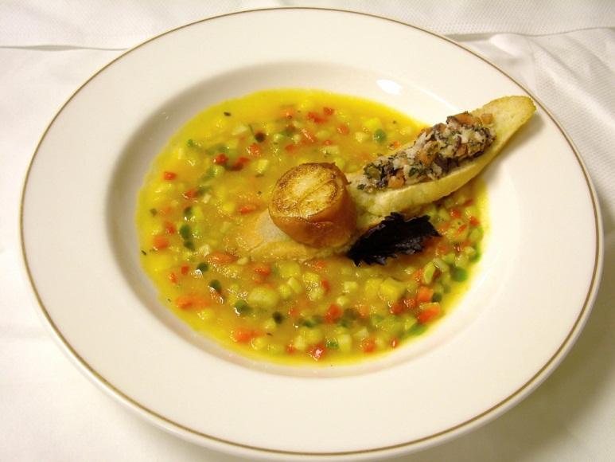
What to EAT
At Restaurants
Water
Build own sandwiches, Subway / Quiznos
Soup and salad, avoid high fat options
Choose grilled meats over fried
Veggies instead of fries
Skip dessert, select fruit
Leftovers for next night
Fast food vs. local market
Notes:
Healthy eating in restaurants:
Order a soup or a salad to eat with your main course. Soups and salads are generally healthy and start to fill you up so that you eat less of the more calorie-dense main meal.
Skip the entrée altogether. Soup and salad might be enough for a healthy meal.
Split a meal with your dining partner. Most restaurants serve huge portions, so there is usually enough food to share. This saves calories and money. Besides, sharing eliminates the temptation to take leftovers back on the road, where they can't be properly stored.
Select foods that are prepared with healthier, low-fat methods. Baked chicken is healthy, but fried chicken has too much fat.
Eat the vegetables. Most entrées come with at least one vegetable. If not, be sure to order a vegetable side dish.
Skip dessert, or choose some fruit. A full meal that ends with a sugary dessert may make you feel sleepy. That might be fine if you are passenger, but a bad idea if you are the driver.

Slide 14
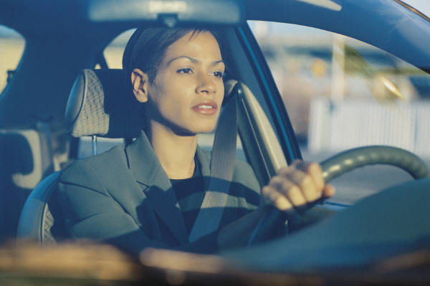
What to Do
Driving, Rest Stop, Walk and Stretch
Get out of your office, walk around
Flying, Walk the airport
Stretch on Plane
Notes:
At the Rest Stop
If you drive for an extended time, be sure to take a break at a highway rest stop. Remember to:
Be safe – watch out for cars moving through the parking lot.
Do some gentle stretches (flexibility exercises). To learn more, go to http://nihseniorhealth.gov/exerciseforolderadults/flexibilityexercises/01.html
Take a short walk either on a sidewalk or inside the building.
At the Airport
• Airport layovers can be a perfect time for physical activity. Here are some simple ways to move at the airport:
Take a 10-minute walk around the airport.
Walk and window shop.
Take the stairs instead of the escalator.
Walk while looking for healthy food choices.
• For longer layovers, some airports now have physical activity facilities that offer a day pass
While on the plane
Place your hands, palm up, on your knees. Raise your palms to your shoulders and back to your knees. Bicep curls
Gently rotate the head from side to side, then gently forward (avoid rotating back).
Raise your shoulders into a shrug, and then lower them. Traps
Raise both legs from the ground; then replace, Raise one leg at a time.
Plant your heels on the floor, and raise and lower your toes.
One foot at a time, “draw” circles while holding your foot just above the floor.

Slide 15
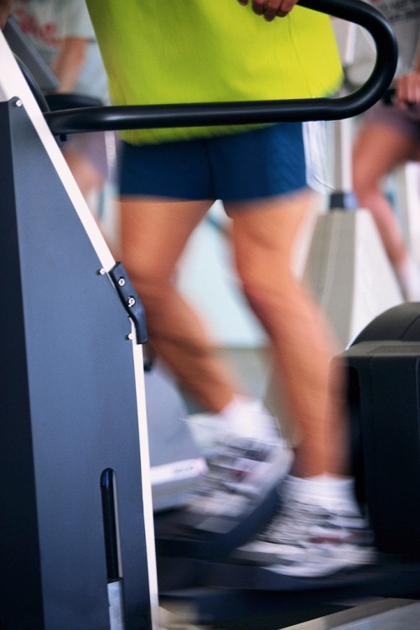
What to Do
In Hotel
Use fitness facility or pool
Ask for safe area to run/walk
Walk to local restaurant
Run/walk the stairs
YouTube video workouts
Exercise in room
Notes:
Ask the hotel staff if the area is safe for walking, nearby walking or running paths.
• If the hotel does not have a pool or an activity room, try one of these ideas:
Bring a jump rope in your suitcase.
Take the stairs instead of the elevator, climb stairs for 15-30 minutes
Walk to local attractions and restaurants.
Do some jumping jacks, sit-ups, and push-ups.

Slide 16
What to Do
Sample Exercise Routine
Jumping Jacks
Sit Ups
Push ups
Jump Rope
Bands
Quality VS. Quantity
Notes:
Demonstrate some exercises

Slide 17
resources
Food Resources
Fast Food Calories by nanobitsoftware.com (free) available at iTunes
My Fitness Pal App/ Lose It App
http://paleomg.com/
http://www.cleaneatingmag.com/
http://www.calorieking.com/foods/
Fitness YouTube Videos
Dorm Room Workout Videos by Exercise TV
SparkPeople.com, 10 minute toning videos

Slide 18
Healthy relationships

Slide 19
relationship MANAGEMENT
Plan a date night/family night
Quality vs. Quantity….PUT YOUR PHONE/COMPUTER AWAY!
Quick meal together
Leave notes for your spouse, kids etc.
Quick phone call
Have something special to look forward to when the “crazy” dies down
No matter who you are with, make the time count!

Slide 20
Don’t be so hard on yourself!

