Slide 1
financial aid communication

Slide 2
talk to me…
+ what works well with your financial aid
communication flow?
+ name some key improvements you have
seen in the area of financial aid communication
at your institution in the last 2-3 years?
what/where are your financial aid communication barriers?
what do you hope to take away from this session?

Slide 3
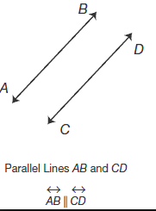
find parallels
+ financial aid publications
+ financial aid search
+ financial aid apply
+ financial aid visit
+ financial aid yield
+ financial aid deposit

Slide 4
what’s with the packets full of random sheets of colored paper?
method
quality
brand
message
intentionality

Slide 5
lets talk solutions
institutional culture & awareness
break down perceived barriers
where do we start?

